Slide 1
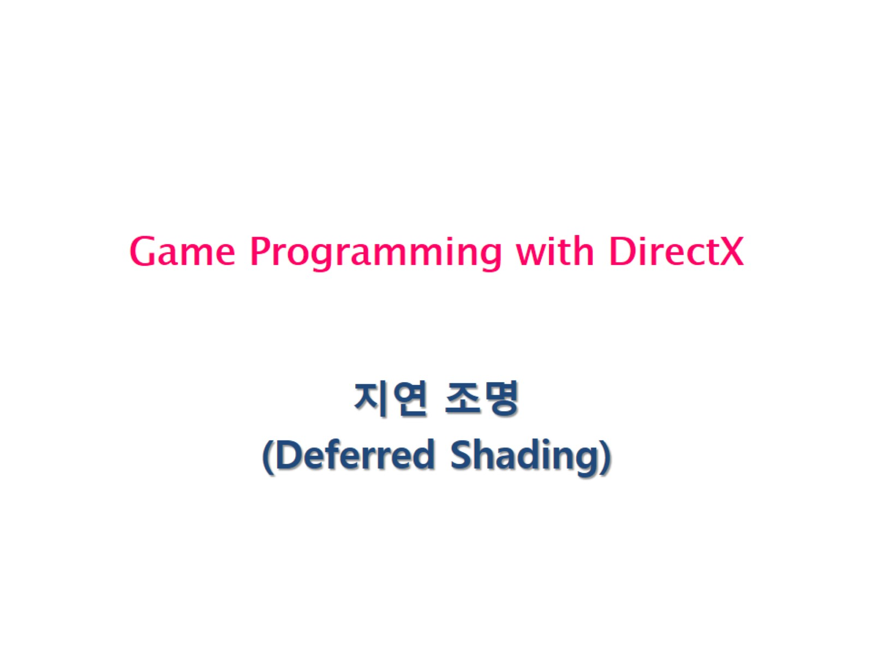
Game Programming with DirectX

Slide 2
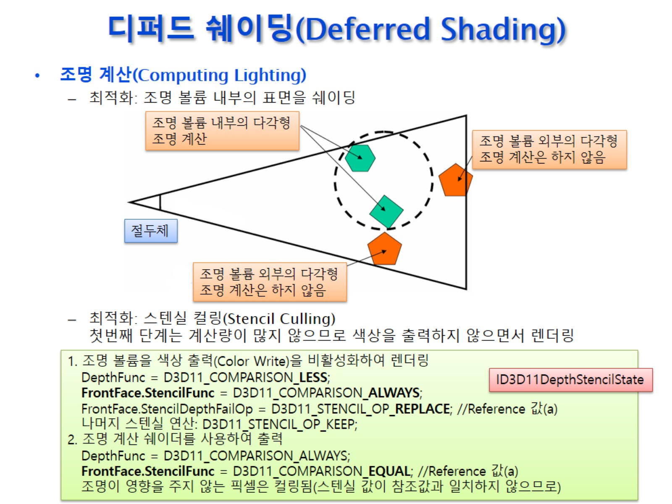
디퍼드 쉐이딩(Deferred Shading)

Slide 3
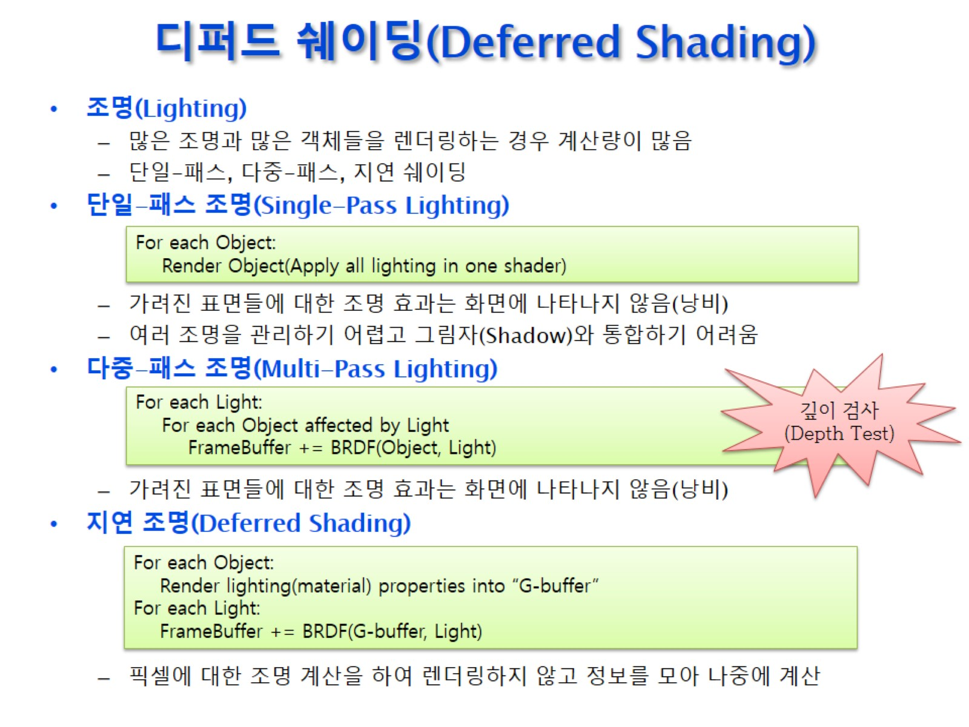
디퍼드 쉐이딩(Deferred Shading)

Slide 4
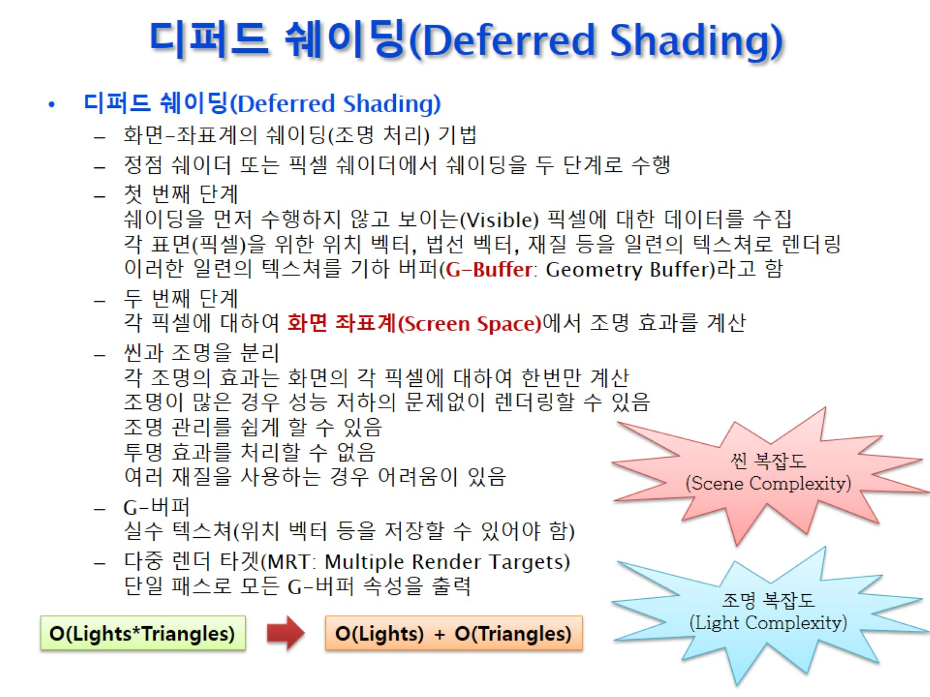
디퍼드 쉐이딩(Deferred Shading)

Slide 5
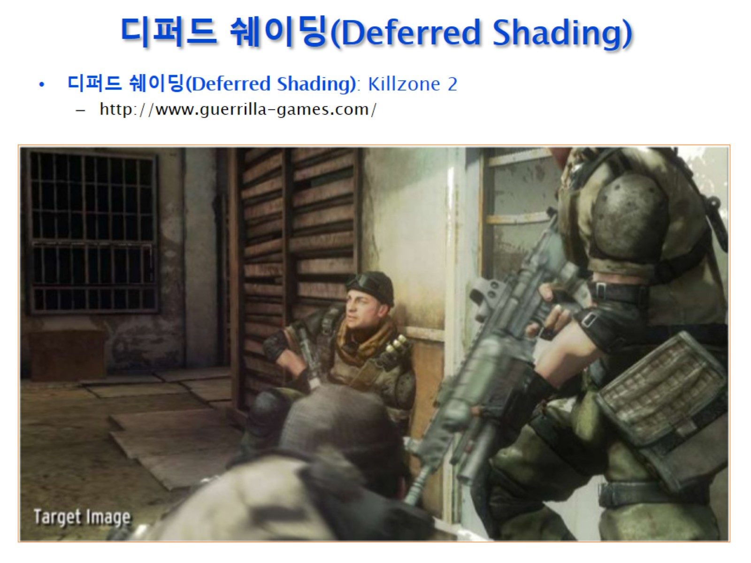
디퍼드 쉐이딩(Deferred Shading)

Slide 6
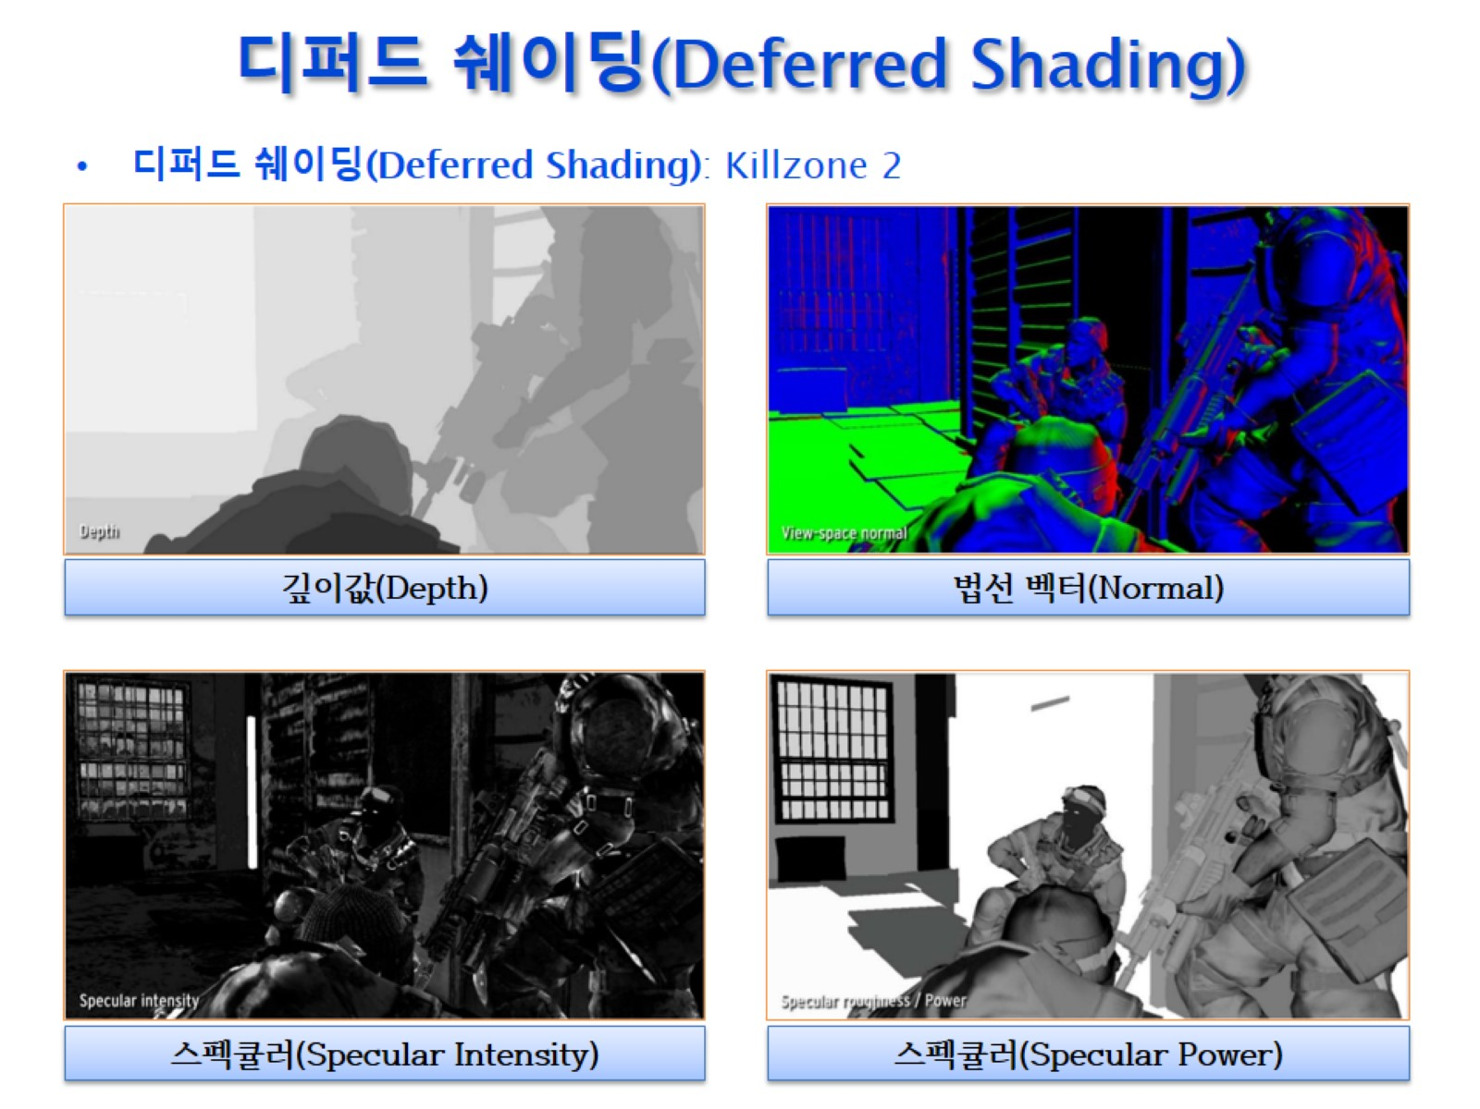
디퍼드 쉐이딩(Deferred Shading)

Slide 7
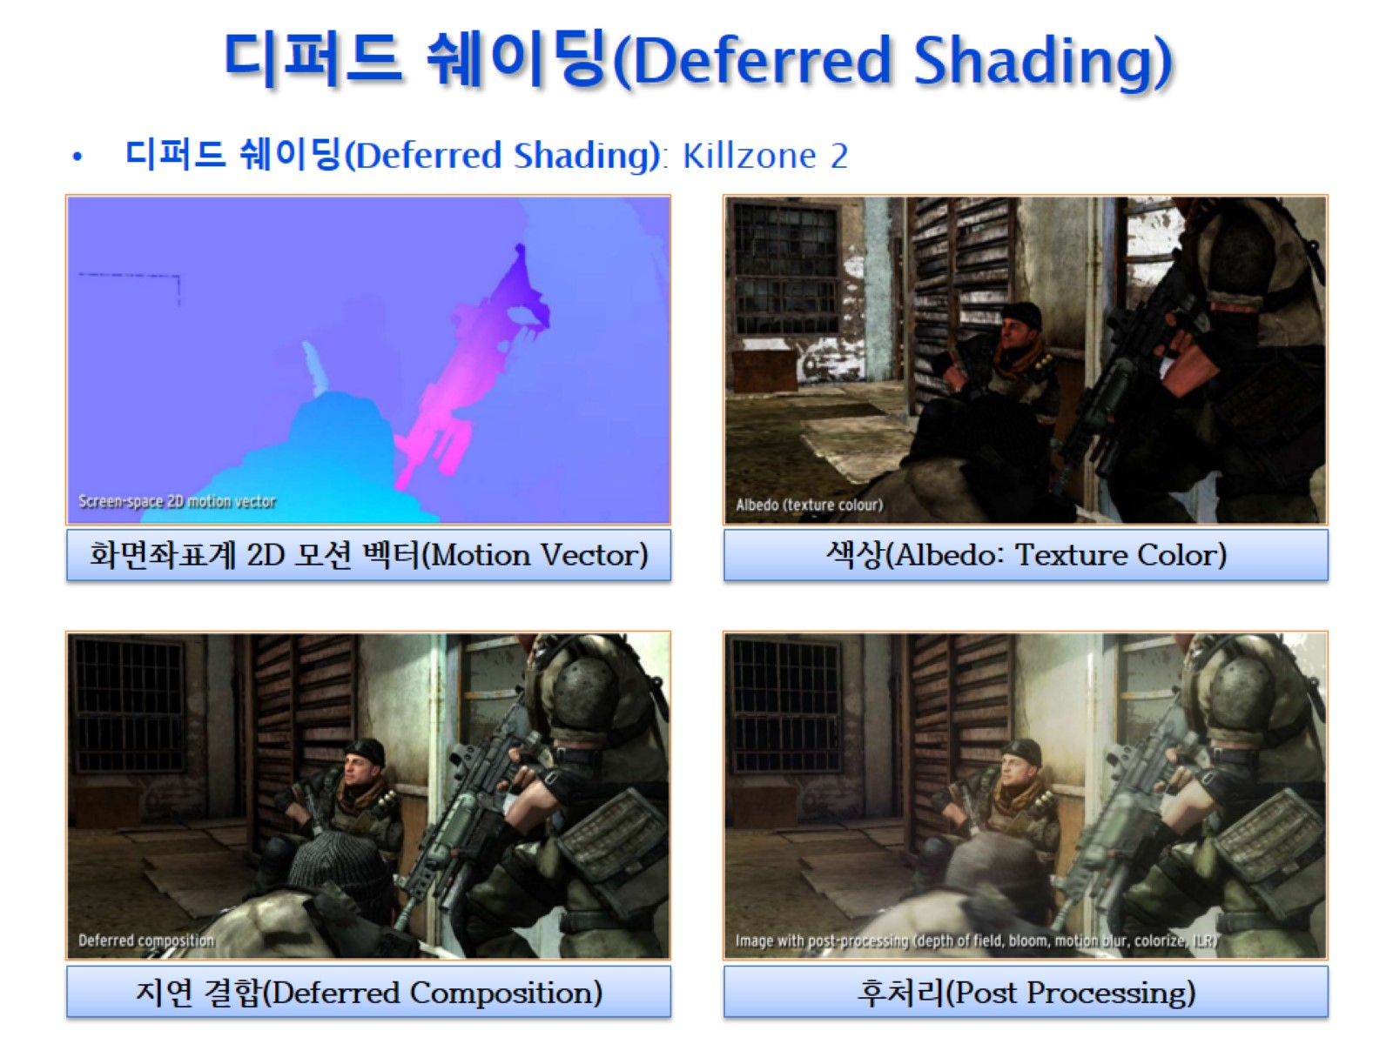
디퍼드 쉐이딩(Deferred Shading)

Slide 8
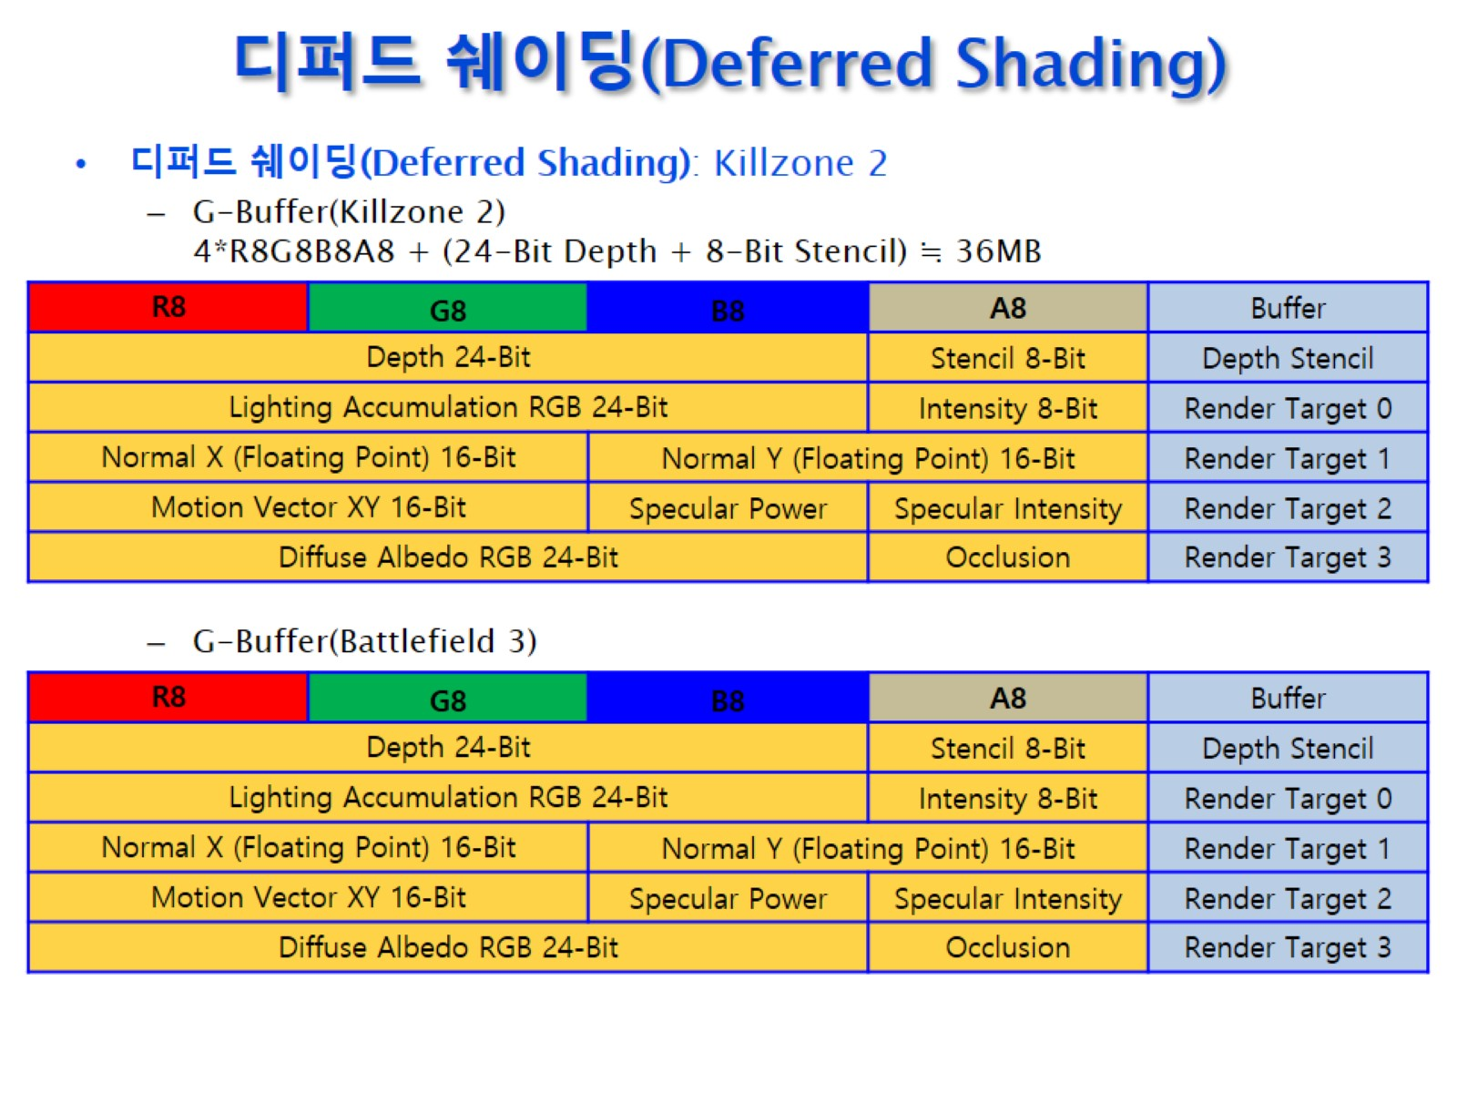
디퍼드 쉐이딩(Deferred Shading)

Slide 9
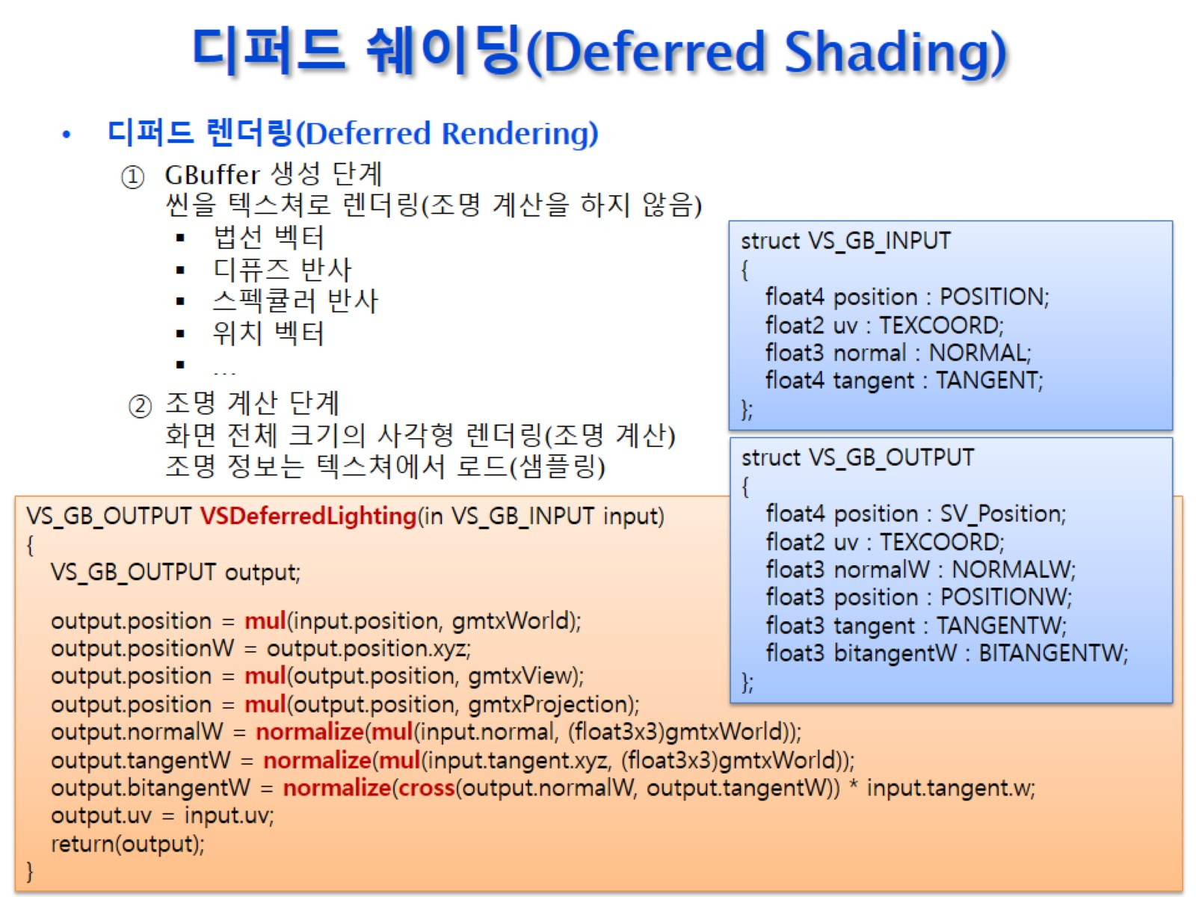
디퍼드 쉐이딩(Deferred Shading)

Slide 10
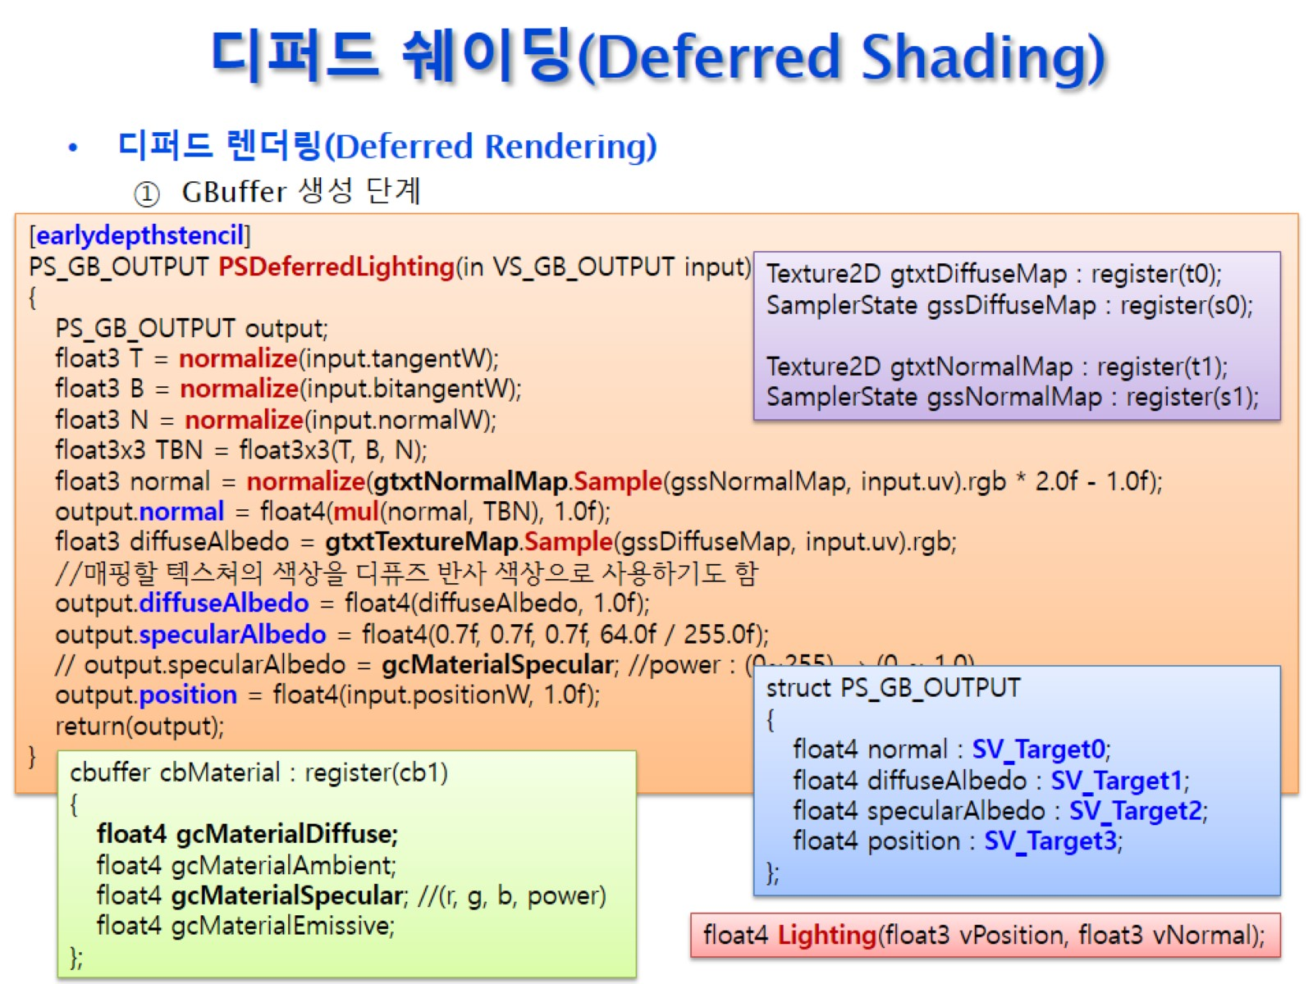
디퍼드 쉐이딩(Deferred Shading)

Slide 11
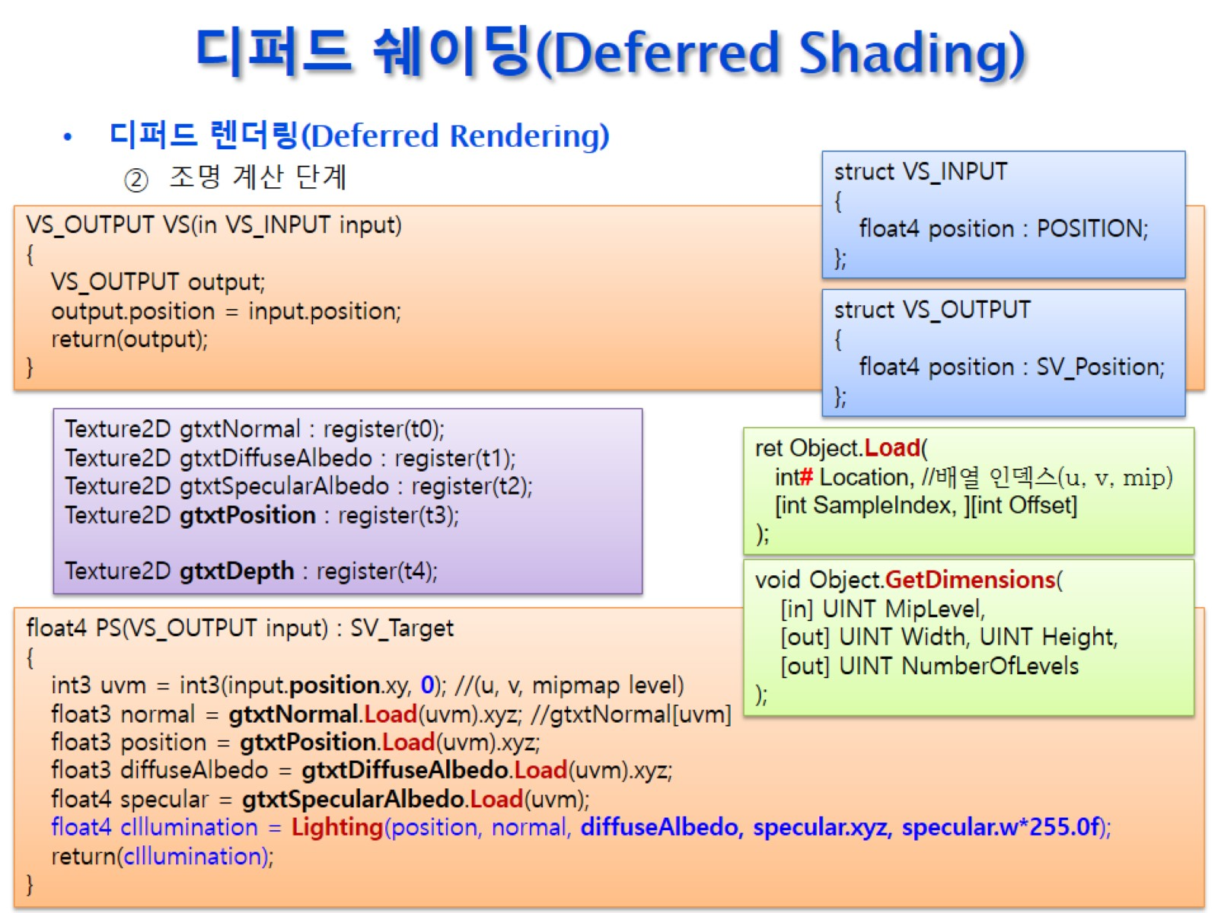
디퍼드 쉐이딩(Deferred Shading)

Slide 12
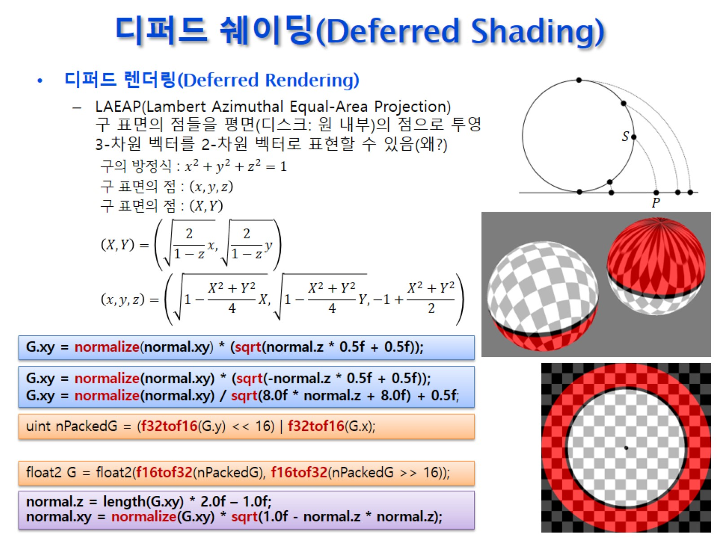
디퍼드 쉐이딩(Deferred Shading)

Slide 13
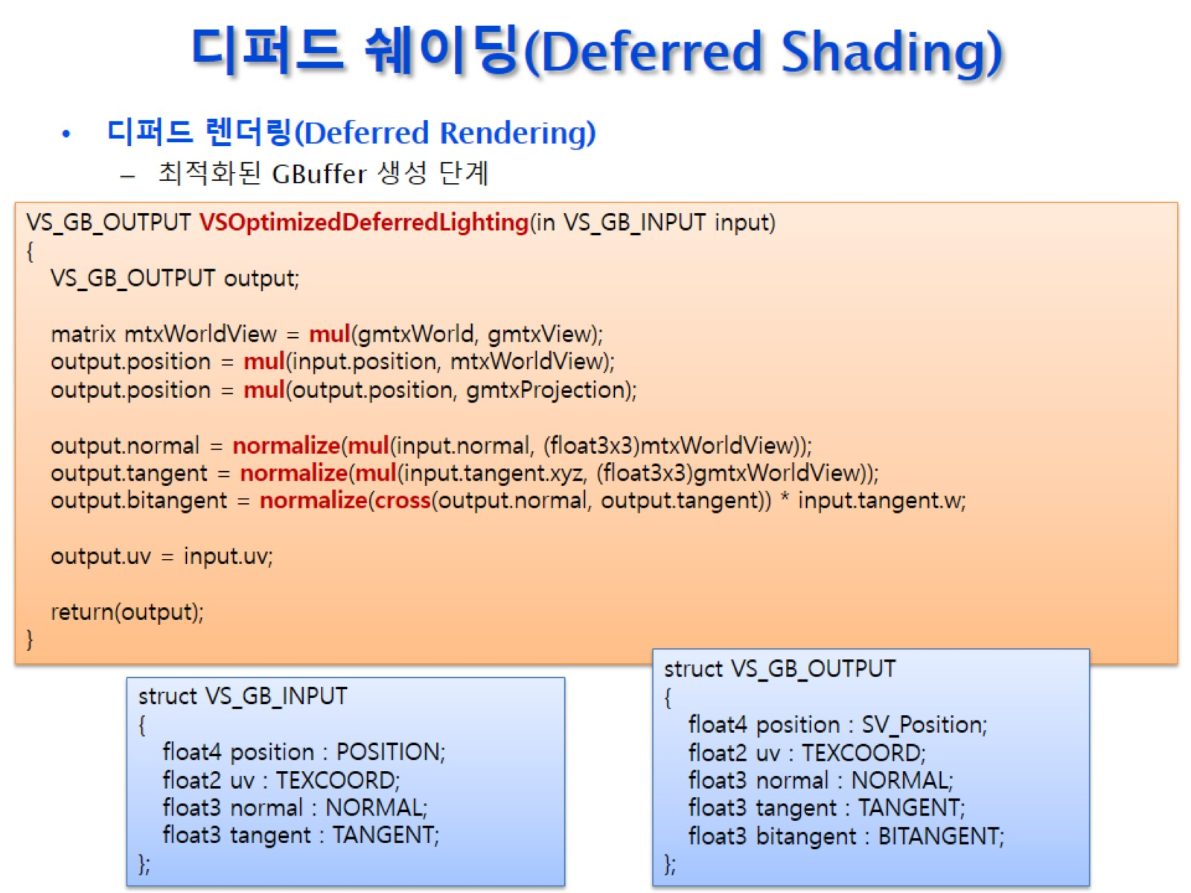
디퍼드 쉐이딩(Deferred Shading)

Slide 14
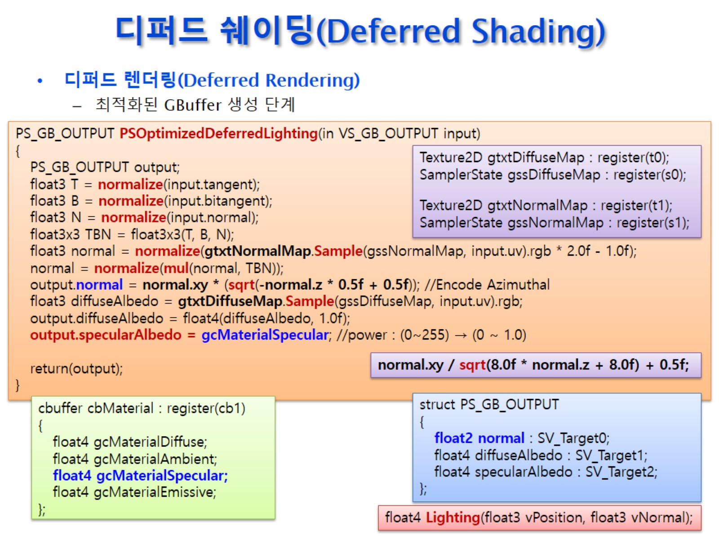
디퍼드 쉐이딩(Deferred Shading)

Slide 15
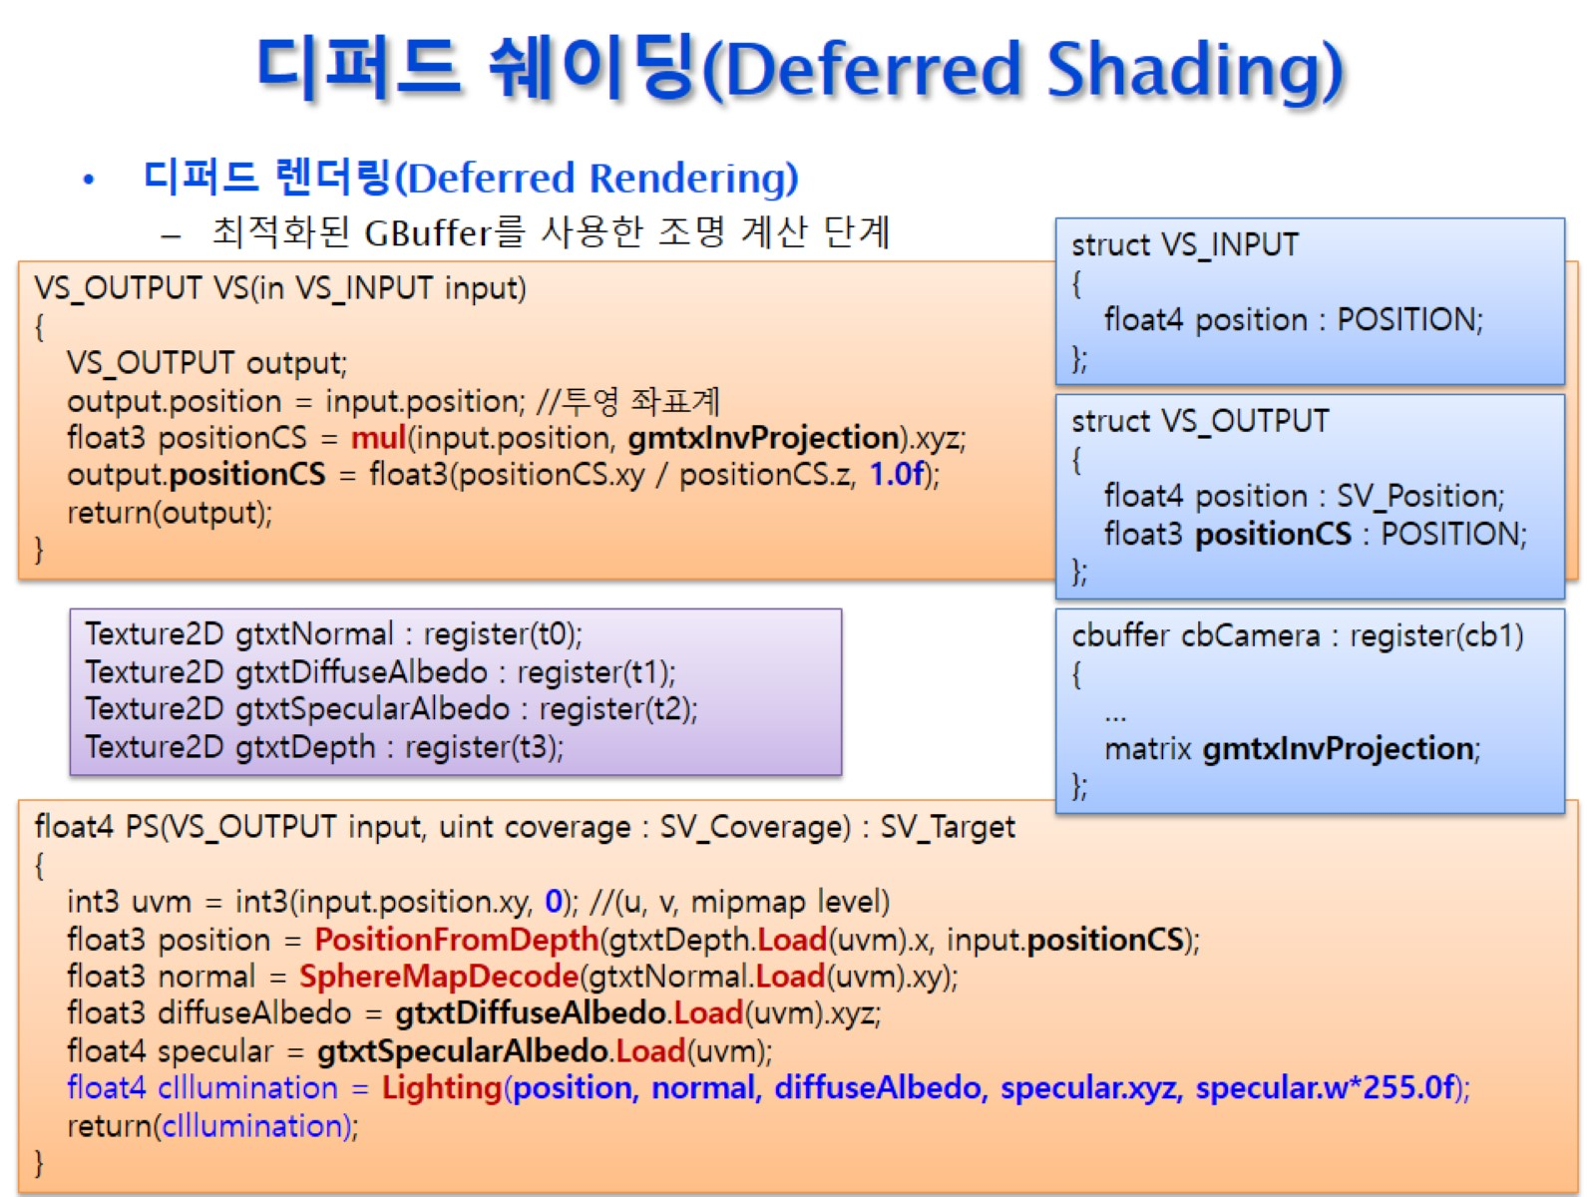
디퍼드 쉐이딩(Deferred Shading)

Slide 16
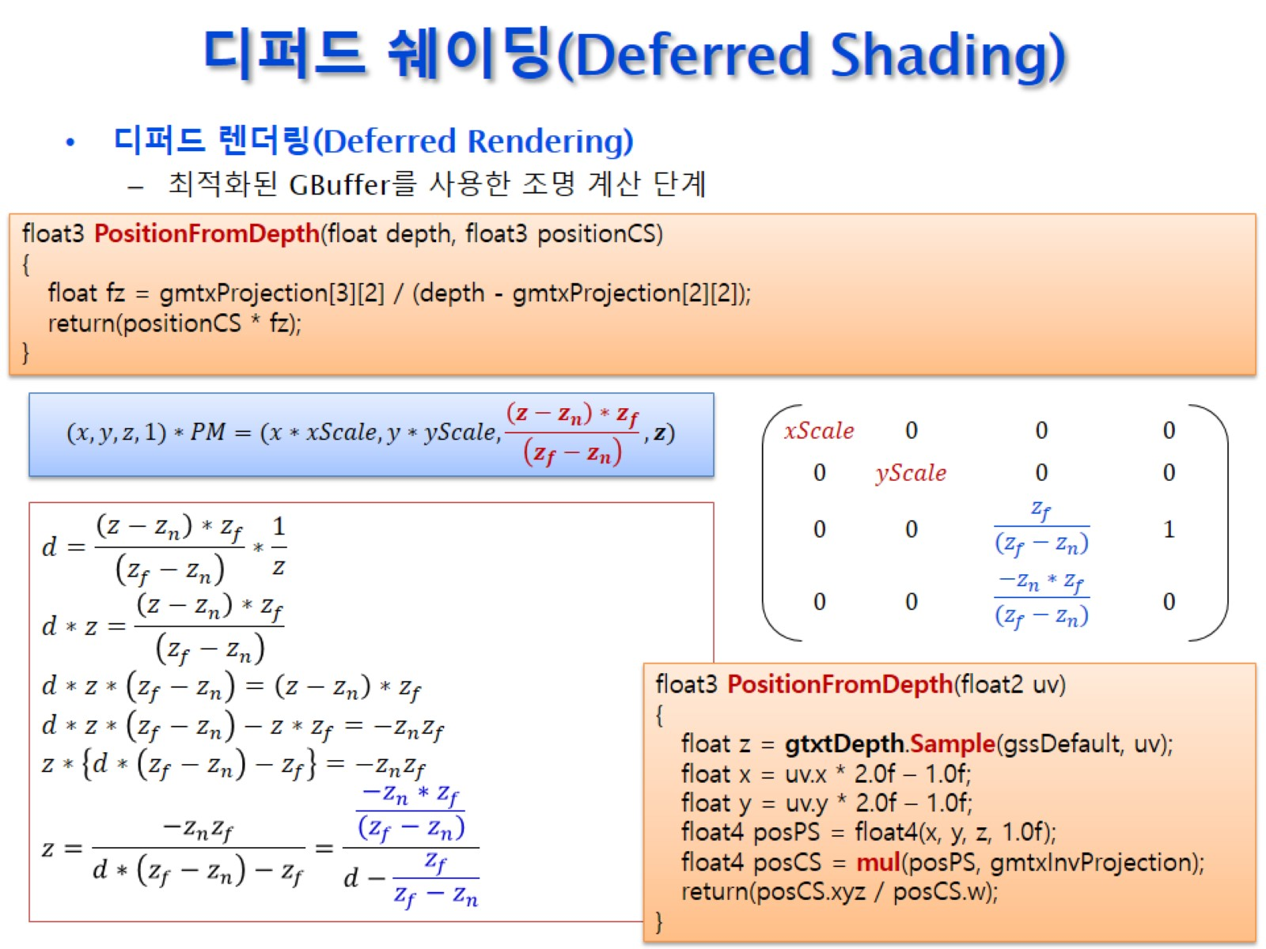
디퍼드 쉐이딩(Deferred Shading)

Slide 17
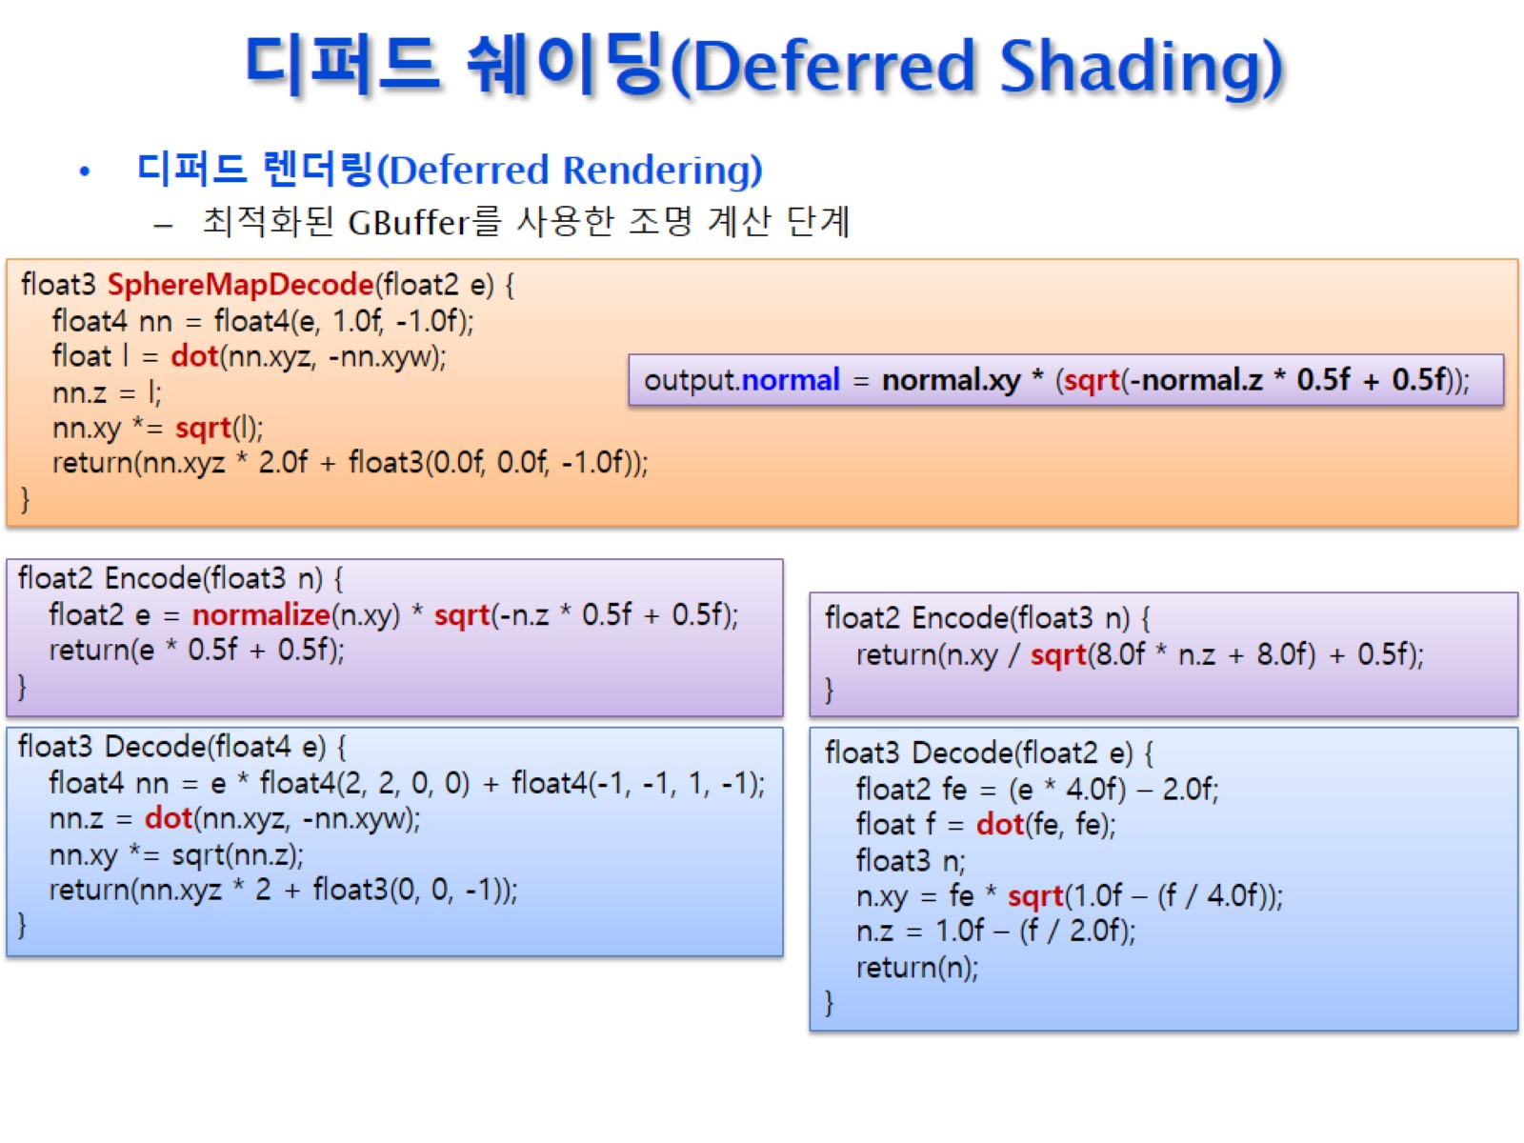
디퍼드 쉐이딩(Deferred Shading)

